Slide 1


Hii,
Iam Siddhika
Welcome to Power BI Series
Part -60

Slide 2



I’m very excited to dive into this with you all!
Are you ready to enhance your data visualization skills?
We focus only on the most used and important Visuals
Today Content
VISUALIZING DATA
VISUALS - SHOWING SINGLE METRIC
NEW CARD VISUAL KPI VISUAL

Slide 3
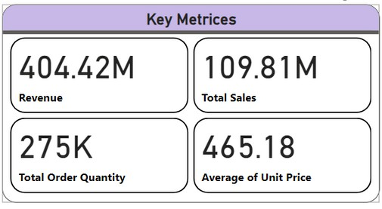


NEW CARD VISUAL
Go and
The new Card visual in Power BI is an enhanced version of the traditional card visual. It allows you to display multiple cards within a single container, providing full control over each card's components and formatting. This update aims to improve performance and accessibility.
explore
formating of
new Card
Visual
When to Use: Display multiple key metrics or KPIs in a compact and customizable format.
Purpose: The purpose of the new Card visual is to provide a more flexible and powerful way to present key data points. It allows users to customize and format their cards
Enhance the visual appeal and interactivity of your reports.
Consolidate several card visuals into
extensively, improving both the aesthetics and functionality of their reports.
one for better performance and easier maintenance.

Slide 4
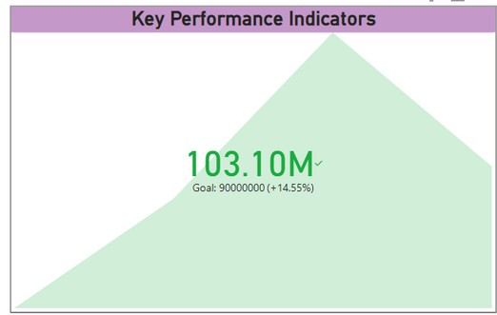


KPI VISUAL
Go and explore formating of KPI Visual
A KPI visual in Power BI is
used to measure progress
specific goal. It
towards a visually current meeting
indicates whether
performance is
expectations by
comparing actual values against target values.
Purpose: The purpose of a KPI visual is to provide a quick and easy way to evaluate how well an organization, team, or individual is achieving their key business objectives. It uses color coding (such as green, yellow, and red) to indicate performance status at a glance.
When to Use: Use a KPI visual when you need to track progress toward a
specific business objective. This visual is helpful in scenarios where you need to monitor key metrics over time and quickly see if they are on track, ahead, or behind target.

Slide 5


Thank you for joining me today to learn about Part -60 of Power BI!
Remember, Effective data visualization is crucial for turning data into meaningful insights and compelling narratives with Power BI.
Stay tuned for more insights and tips on Power BI in our next Series.
Follow
Siddhika Shah

